Slide 1
Gestation length
animal | Gestation length (day)
cattle | 275-285
mare | 330-335
sheep | 145-151
goat | 149-155
camel | 390
buffalo | 310-315
dog | 60-63
cat | 55-65

Slide 2
Gestation length
The factors which affect on gestation length

Slide 3
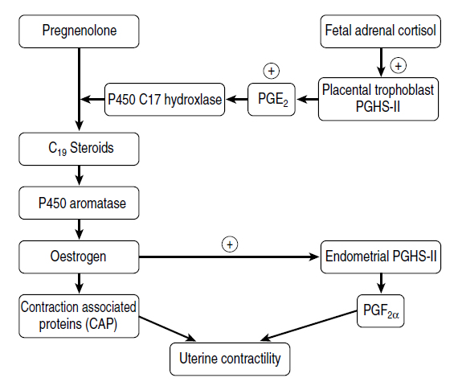
Parturition
Stress factor

Slide 4
Gestation length
The factors which prolong the gestation length
Genetic factors
Species (cattle and mare)
Breed (Holstein 275, Brahman 295)
Type of fetus (mare pregnant with foal or mule)
Inbreeding
Inbreeding mating in swine prolong the gestation length 2-4 weeks
Deficiencies in minerals especially iodide
Induced and normal goiter prolong the gestation length 4-10 days

Slide 5
Gestation length
The factors which prolong the gestation length
Deficiencies in vitamin A
Deficiencies in vitamin A in ewes prolong the gestation length 1-4 weeks
Anomalies in fetus
Defect or anomalies in fetus pituitary gland
Defect or anomalies in fetus adrenal gland
Sex of the fetus
In cows, the male fetus prolong the gestation length 1 week

Slide 6
Gestation length
The factors which prolong the gestation length
Dead fetus
Mummified fetus prolong the gestation length
Induce prolonging in gestation length
Experimentally by injection of progesterone

Slide 7
Gestation length
The factors which minimize the gestation length
Twining
In cows the twining decrease the gestation length 3-6 days
The age of dam
In cows the first and second pregnancy shorter than the 3ed and 4th one
Diseases
For placenta or uterus (abortion)
For fetus (abortion)
Stress factor and general disease

Slide 8
Gestation length
The factors which minimize the gestation length
Hyper atrophy of adrenal gland
Hormonal treatment
ACTH
Prostaglandin
Estrogen

Slide 9
Maintenance of pregnancy
First month of pregnancy
Food supplementation
Yolk sac, uterine milk and the primary attachment between the fetal membrane
Prevention of luteolysis
Maternal recognition of pregnancy (interferon)
Pregnancy-specific protein, protein B may help maintain the corpus luteum of pregnancy in cows and ewes.
Cervix closure and uterine relaxation
Progesterone
Immune rejection
Placenta antigenicity, progesterone and interferon

Slide 10
Maintenance of pregnancy
Second stage of pregnancy
Food supplementation
Development of placenta
Thyroid, parathyroid, adrenal cortex, and other endocrine glands
Produce secondary hormones of reproduction are important to maintenance metabolic state in mother and proper fetal development
Second source for progesterone
Ewe depend on placenta especially after day 50
Cow after 5th or 6th month depend on corpus luteum and placenta
Mare after day 40 it depend on accessory corpus luteum till day 150 will be depend on placenta
Sow and doe depend completely on corpus luteum

Slide 11
Maintenance of pregnancy
Fetus stage of pregnancy till parturition
Food supplementation
Development of placenta
High amount of progesterone to maintain pregnancy
Progesterone from placenta (cow) accessory corpus luteum (mare)
Increasing in the estrogen (the source of estrogen is placenta)
Increase the uterine blood flow (important for nutrition, gas exchange and waste excretion and fetal development)
Regulator for fetal growth and tissue differentiation
Synergize with progesterone in development and preparation of the mammary gland

Slide 12
Maintenance of pregnancy
Fetus stage of pregnancy till parturition
The effect of relaxin and relaxin like factors produced by the corpus luteum (sow and cow) and the placenta (mare)
Softening of connective tissue, which permits the uterine muscles to stretch to accommodate the growing fetus
Expansion for the pelvic canal particularly during late gestation

Slide 13
Pregnancy diagnosis
Cessation of estrus
External observation (abdomen, udder, vulva)
External Ballottement
Progesterone Analysis of Milk or Serum
Pregnancy-associated Proteins (protein B)
Ultrasonography
Trans rectal palpation

Slide 14
Trans rectal palpation
Positive signs of pregnancy
Palpation of the chorio-allantoic membrane by the “membrane slip” technique
Palpation of the amniotic vesicle
Palpation of the fetus
Palpation of the placentomes

Slide 15
Trans rectal palpation
Additional findings may support pregnancy and may be useful in estimating gestational age
Location of the uterus and cervix
Thinning of the middle uterine artery wall, and palpation a pulse in it
Size of the uterine horn and discrepancy in size of the uterine horns
Presence of fluid in the uterus

Slide 16
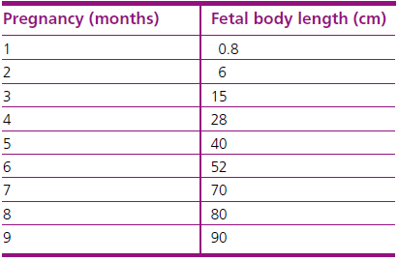
Trans rectal palpation
The size of fetus according to the gestation age (cow)

Slide 17
Pregnancy diagnosis
The finding according to the gestation age
Real time ultrasound (direct imaging) 13–21
Failure to return to estrus and persistence of CL 21
Progesterone concentration in plasma or milk 21–24
Assay of pregnancy specific protein B (PSPB) or pregnancy-associate glycoprotein (bPAG) 24
Palpation of the allantoic chorion (‘membrane slip’) 33

Slide 18
Trans rectal palpation
The finding according to the gestation age
Unilateral enlargement of horn and disparity in size, thinning of the uterine wall, fluid-filled fluctuation of enlarged horns 35
Palpation of the early fetus when amnion loses its turgidity 45–60
Palpation of placentomes 80
Hypertrophy of the middle uterine artery 85
Estrone sulphate in blood and milk 105
Palpation of fetus 120

